Slide 1
Process
Page
Start/End
Decision
EULA license agreement terms & conditions
If user is a
residence owner
Yes
No
Share link
to visitor
choose method
To share(sms,email,etc)
Download
app
Login screen
Login screen
For Residents
If guest doesn’t have
the app
Open the app
Visitors
No
Yes
Guest login
Visitors
records
Register for
a visit
Pending
Visitors
granting
access
approve
Visitors notification
approved
Visitor’s
form
reject
Visitors notification
reject
submit form
To the host
Wait for the
approval
from host
Facility
qr access Has
been given

Slide 2
what is start/end in user flow?
If family/relatives do
not have the SPFM app
No
Property owner
need to share link
Choose preferred
Method(email,sms,etc)
Donwload SPFM app

Slide 3
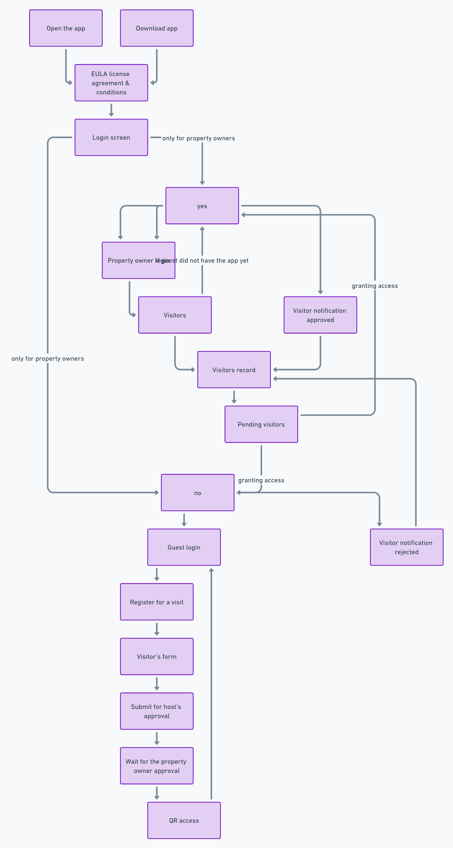

Slide 4
Start/End
Page
Process
Open the App
Login Screen
Main Screen
Home Work
Time Table
Classes Icon
Leave Application
Apply Leave Icon
Submit
Application
Tap On
Subject
Select Classes
Subject
Leave Application
Details
Attachment Home Work
From Teacher
Attend Class

Slide 5
Home
Property and Facilities
Management Services
About SPFM
Real Estate Services
SPFM App
Contact Us
Download SPFM App
The Services
Log In
The Firm
Our People
Our Partners
Contact Us
The Services
Log In

Slide 6
The task flow assumes that the visitor intends to inquire
about house prices or view a list of available housing offerings.
Start/End
Page
Process
Decision
Property Agent
Property and
Facilities Services
Real Estate
Services
Interested in
Finding new Property
Yes
Find a New
Property with SPFM
Interested to Find More
About SPFM Property
Yes
Home
About SPFM
SPFM App
Google Search
No
No
Leaves
the Website
Leaves
the Website

Slide 7
